Slide 1
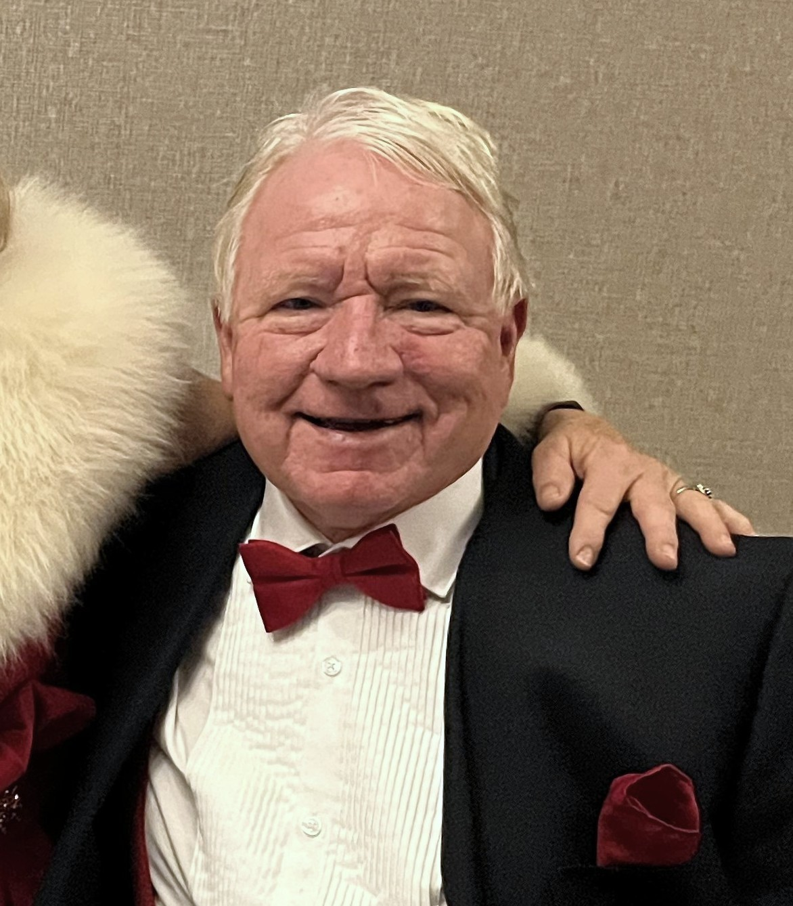

Ron (Ronbo) Templeton
Forever Rotary
Silverdale Rotary Club
1981-2025
16 Mar 2025

Slide 2
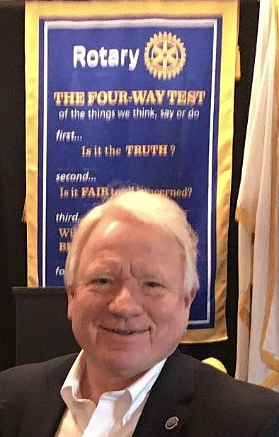
Ron Templeton – May 19, 1953 to January 30, 2025
Silverdale Rotary Club 1981-2025
Club President – 1990-91
Champion of The Rotary Foundation
Membership Chair
Multiple Paul Harris Fellow
Exchange Student Host multiple times
Avid Husky Fan

Slide 3
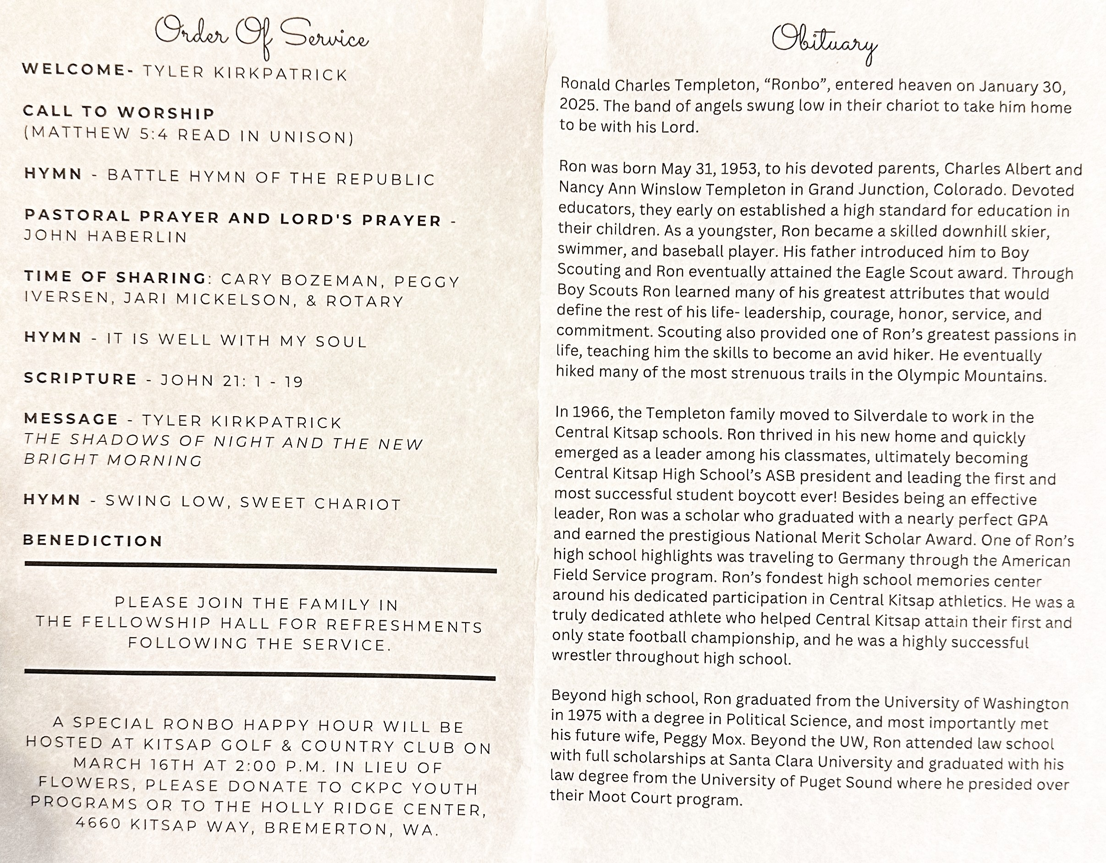
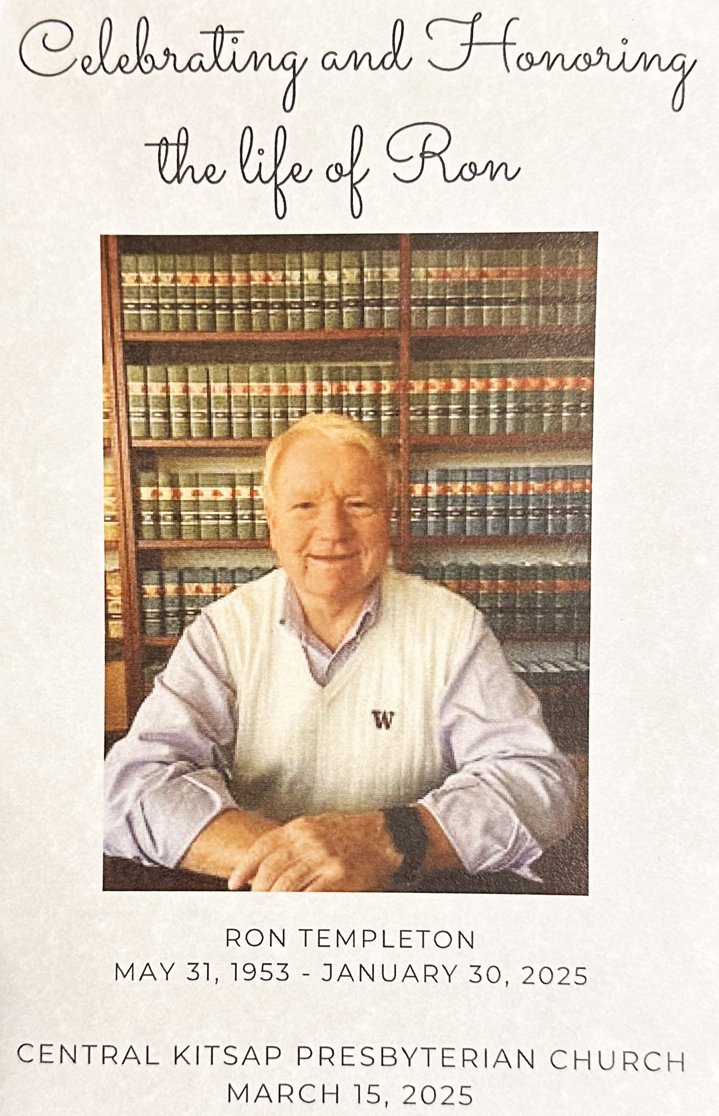

Slide 4
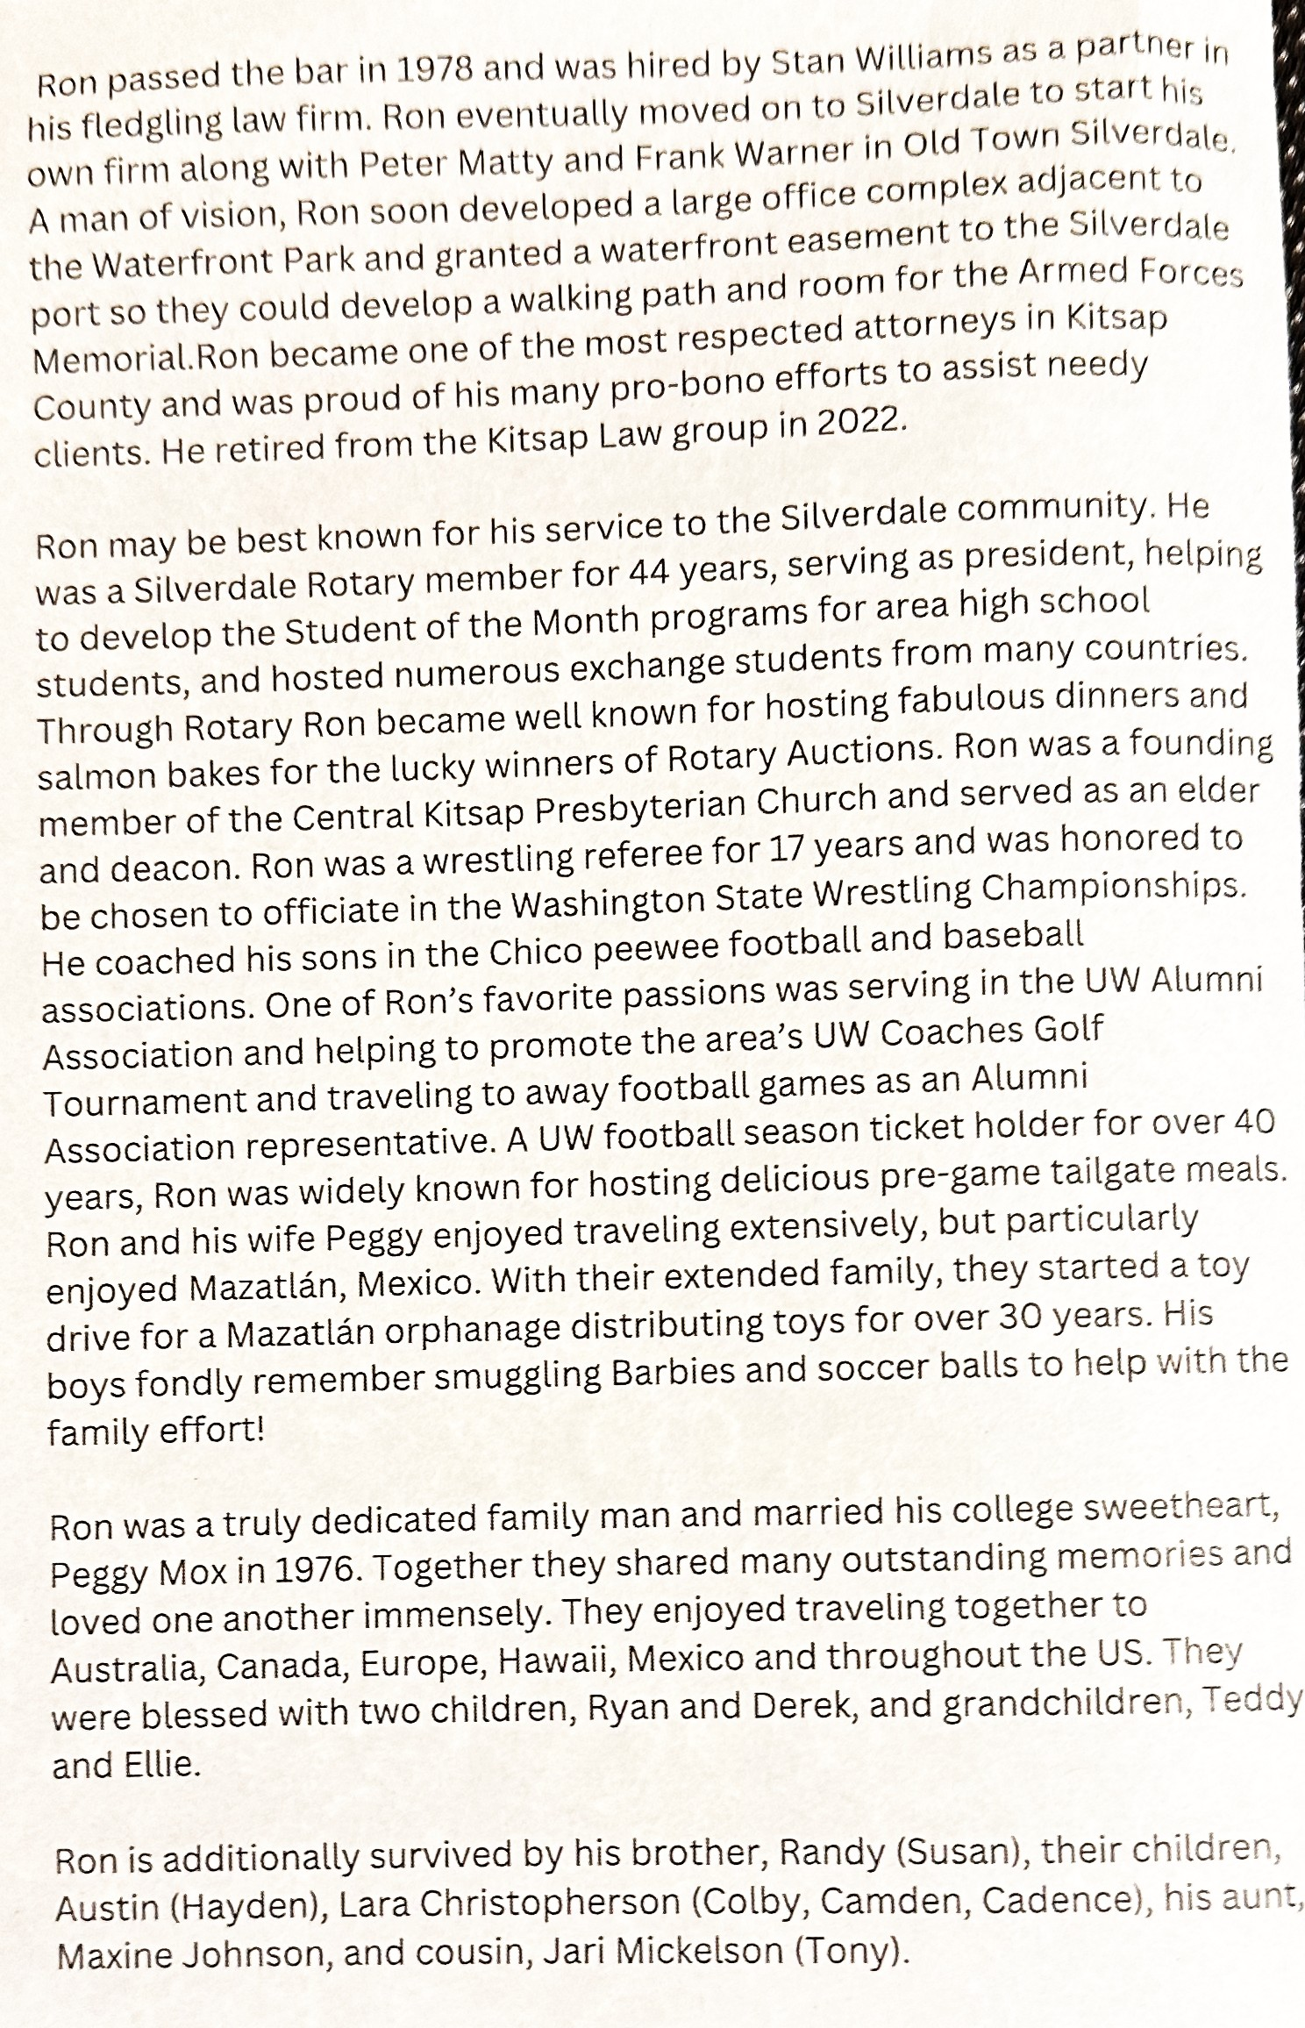

Slide 5
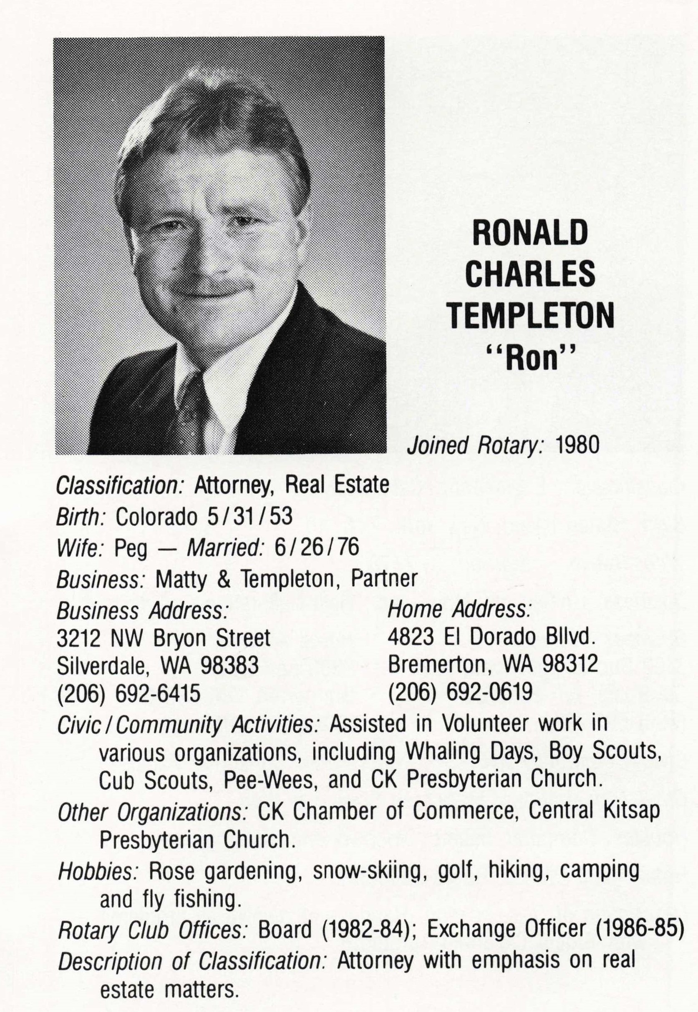
The Old Days Silverdale Rotary 1988-89 Directory

Slide 6
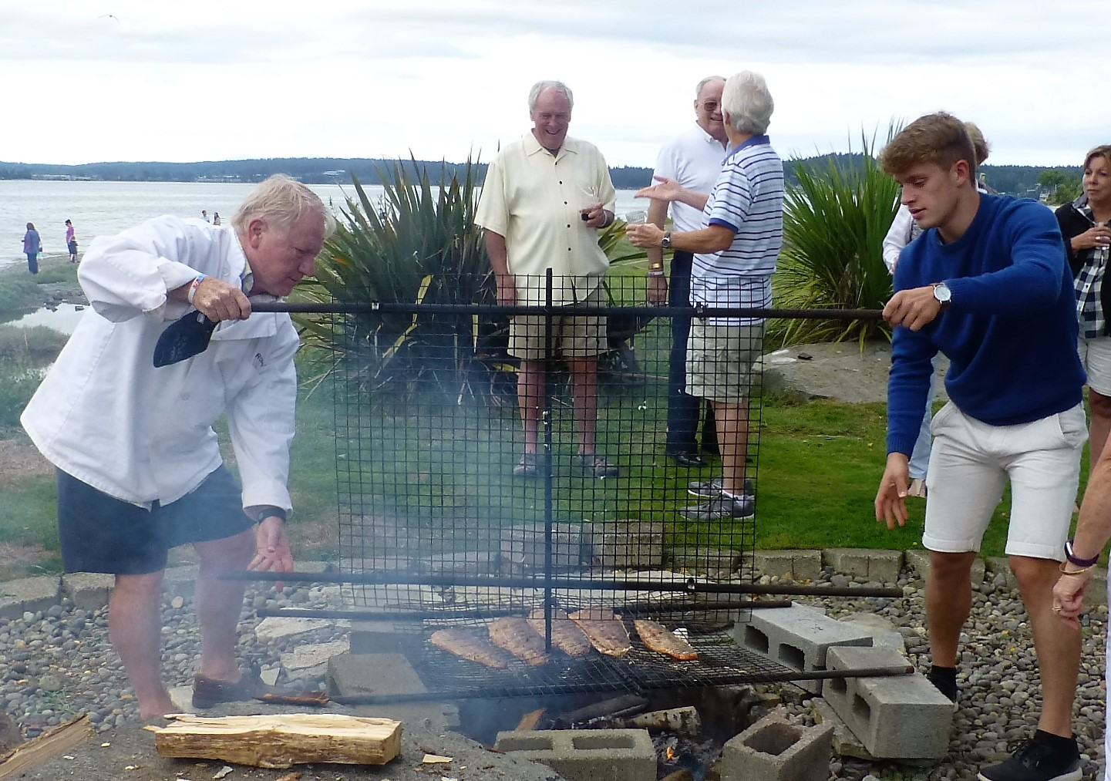
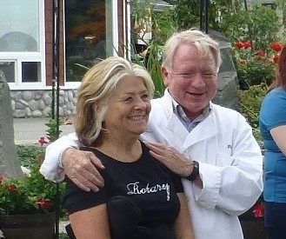
Annual Salmon Bake – Welcoming Exchange Students
Gourmet Chefs
Ron and Peggy
Matej Kunak - Slovakia

Slide 7

Annual Salmon Bake – Welcoming Exchange Students
Ruby Peng - Taiwan

Slide 8
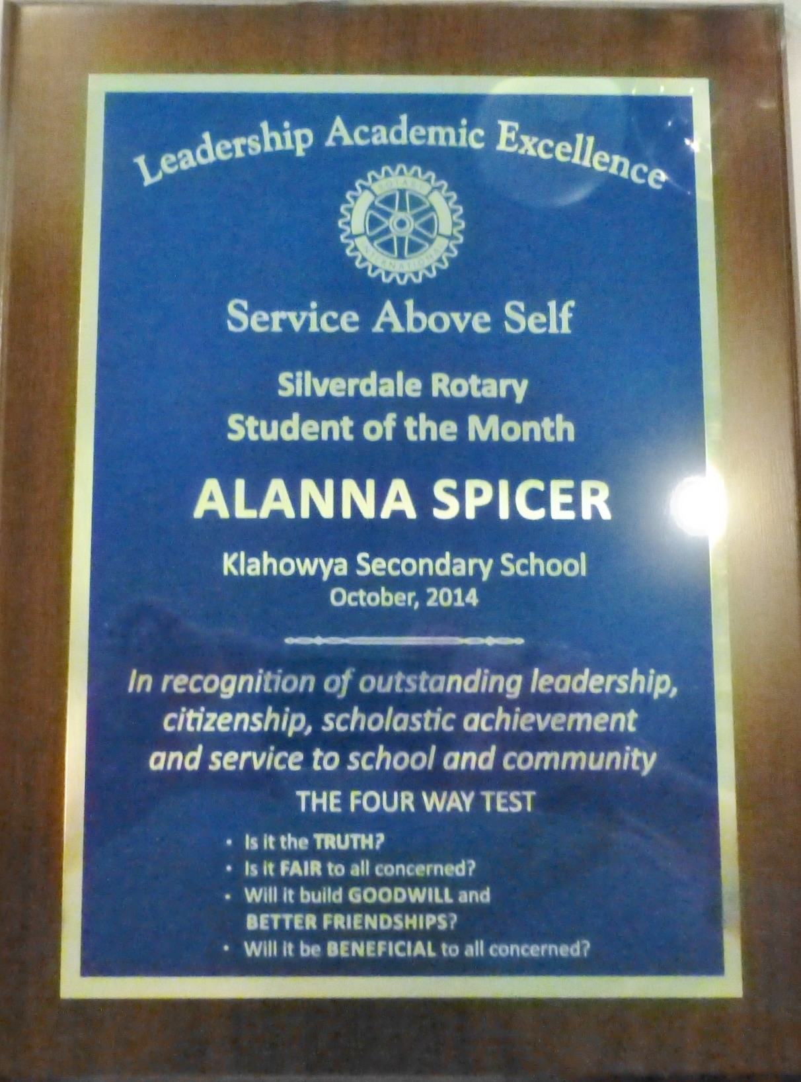
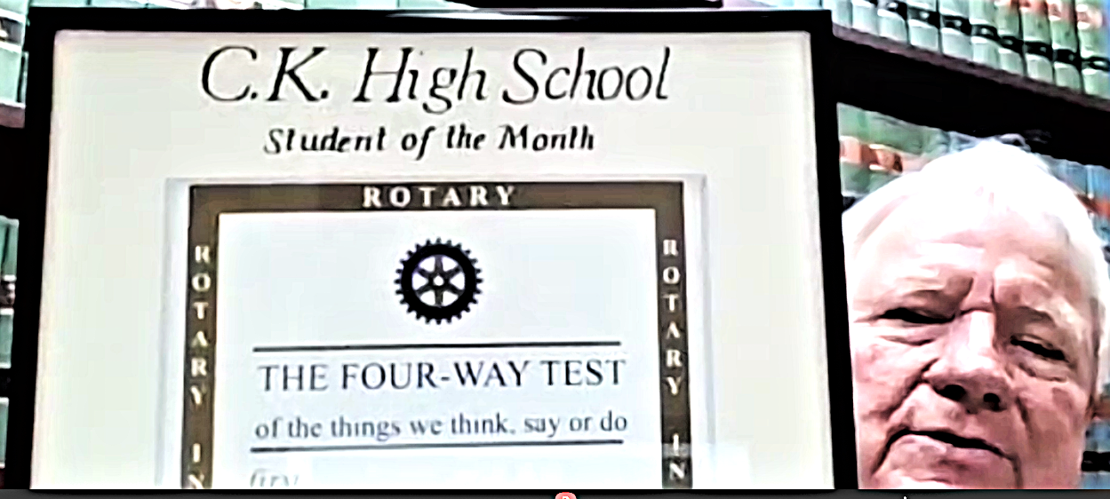
Students of the Month for CKSD

Slide 9
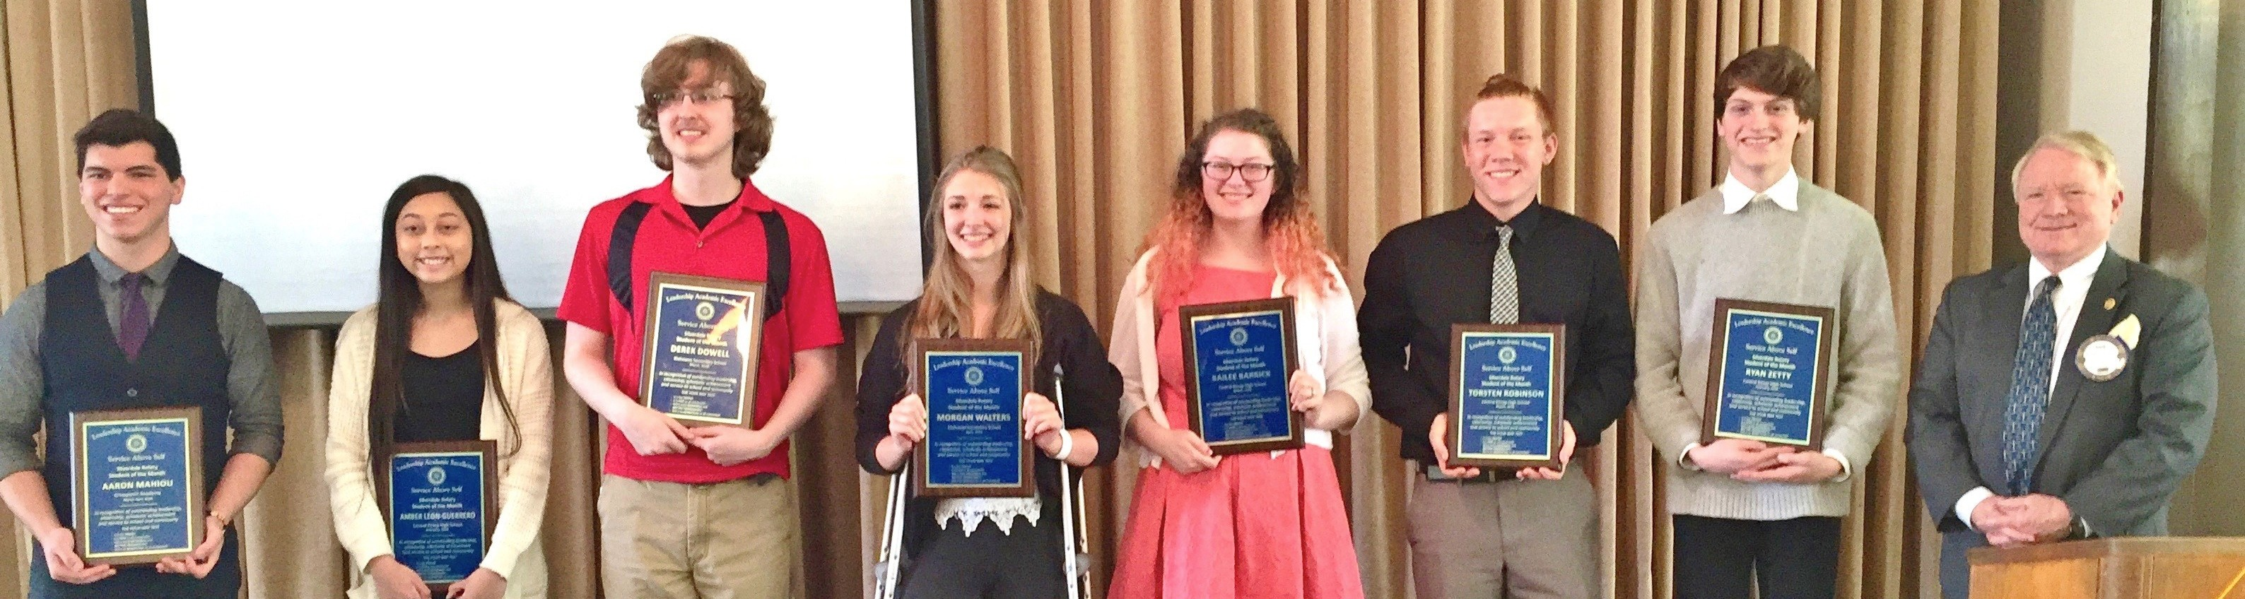
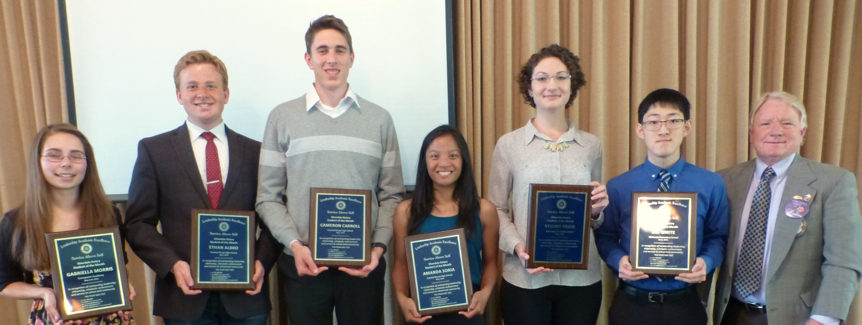
Students of the Month for CKSD

Slide 10
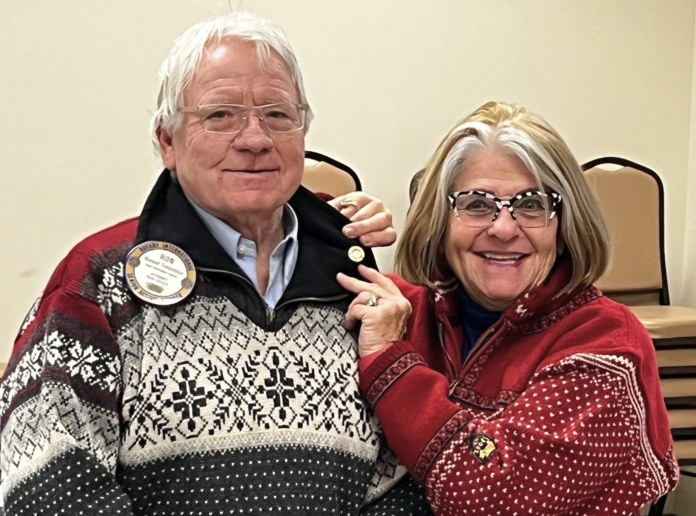
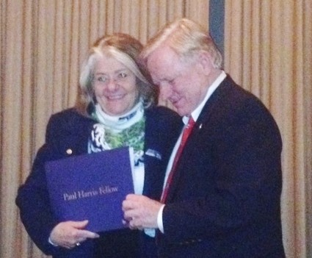
The Rotary Foundation Champion
Multiple Paul Harris Fellow

Slide 11
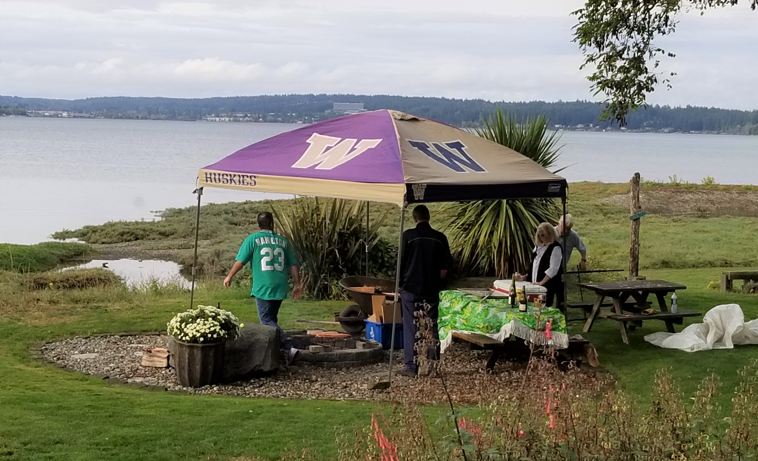

University of Washington Huskies!

Slide 12
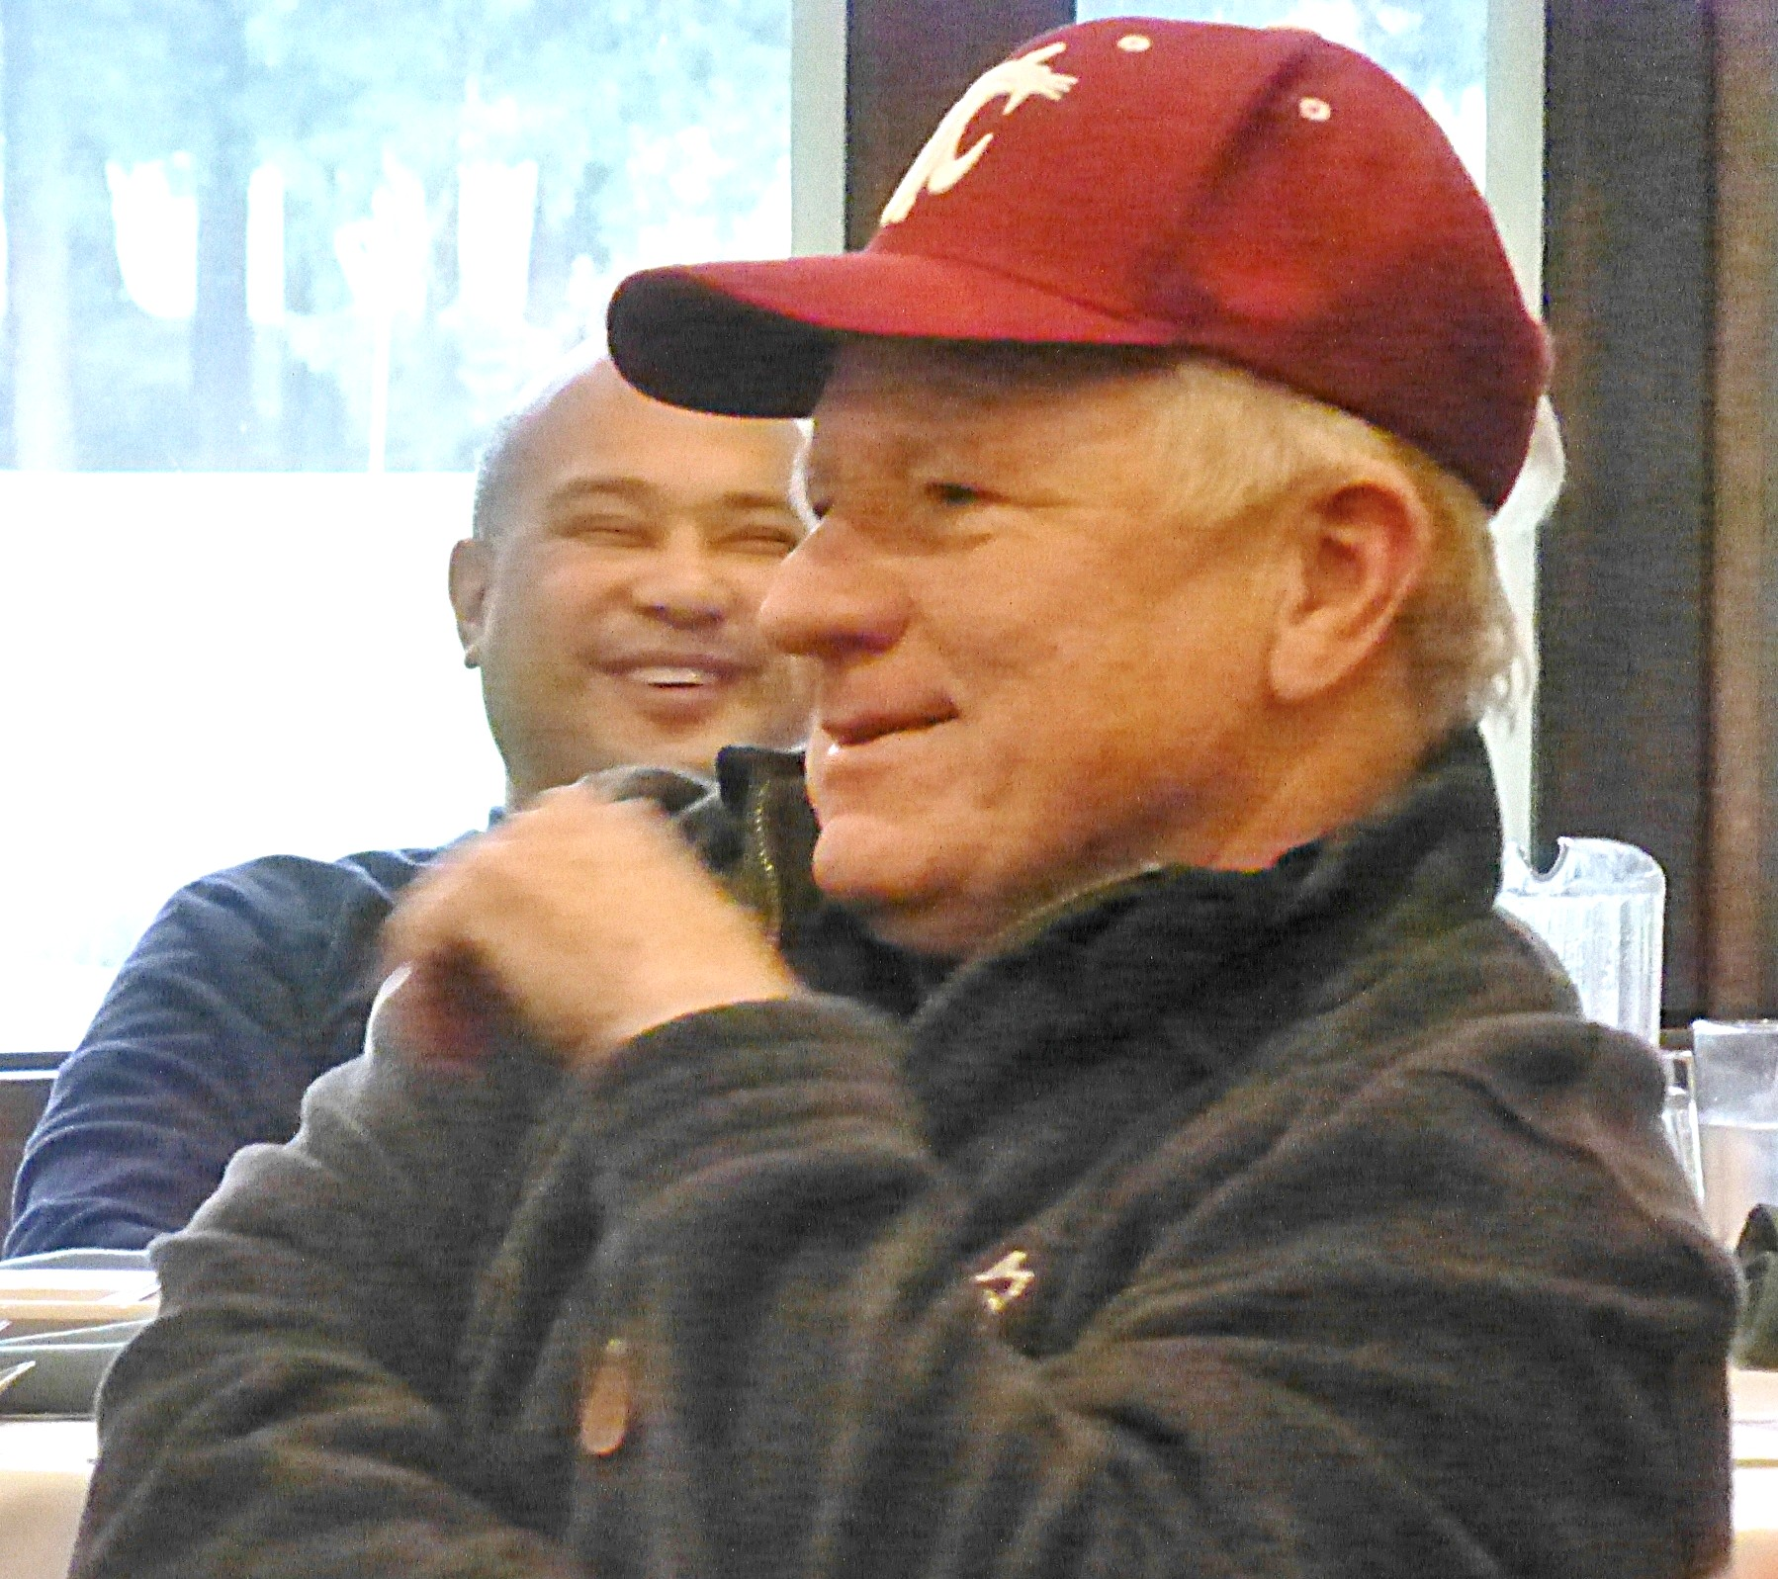
Ron in WSU Cougar Garb?!
“Mixed Family” – son attending WSU

Slide 13
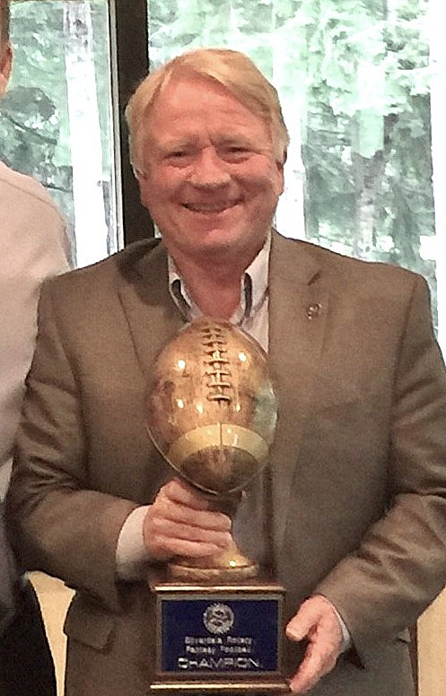
Avid, Competitive Football Fan
Silverdale Rotary
Fantasy Football Champion!

Slide 14
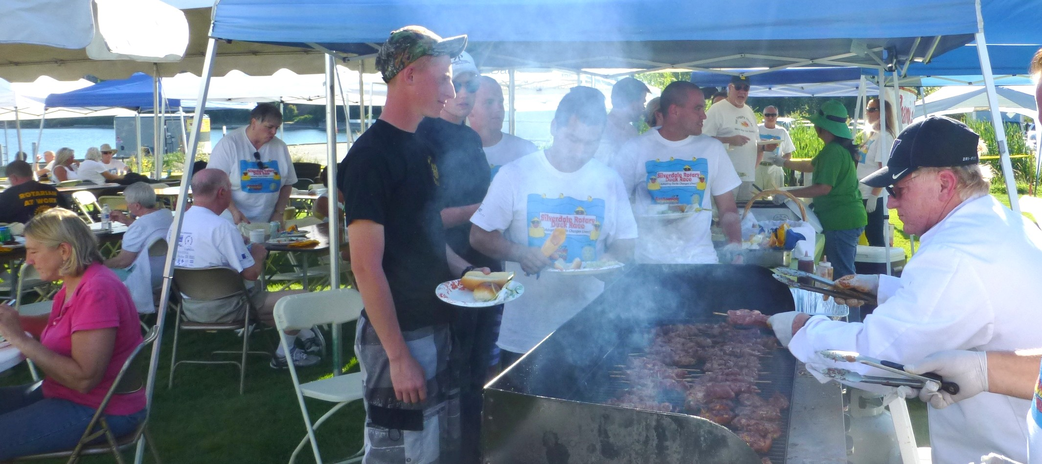
Duck Race
Chef Ron feeding the crowd after the Race

Slide 15
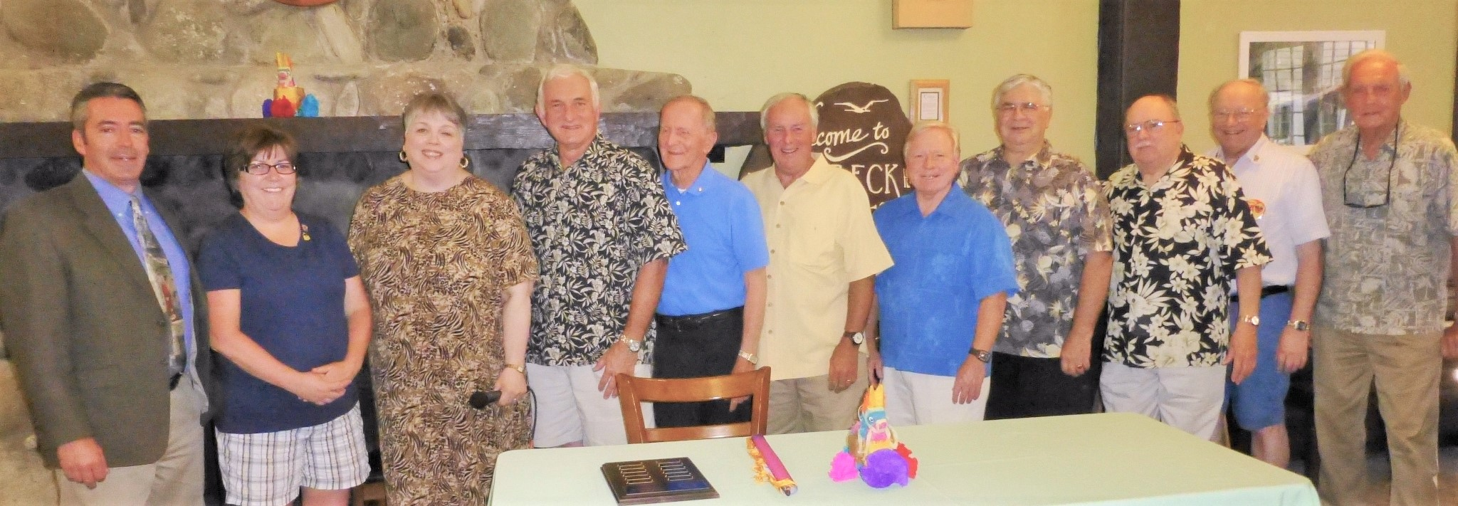
President 1990-91
Pictured: Past Presidents at 2017 Installation Dinner
Left to right: Ed Hamilton, Mary Hoover, Elayne Burton, Scott Slocum, Roger Aydt, Peter Matty, Ron Templeton, Larry Rodgers, Don Taylor, Brian Beagle, Jack Jensen

Slide 16
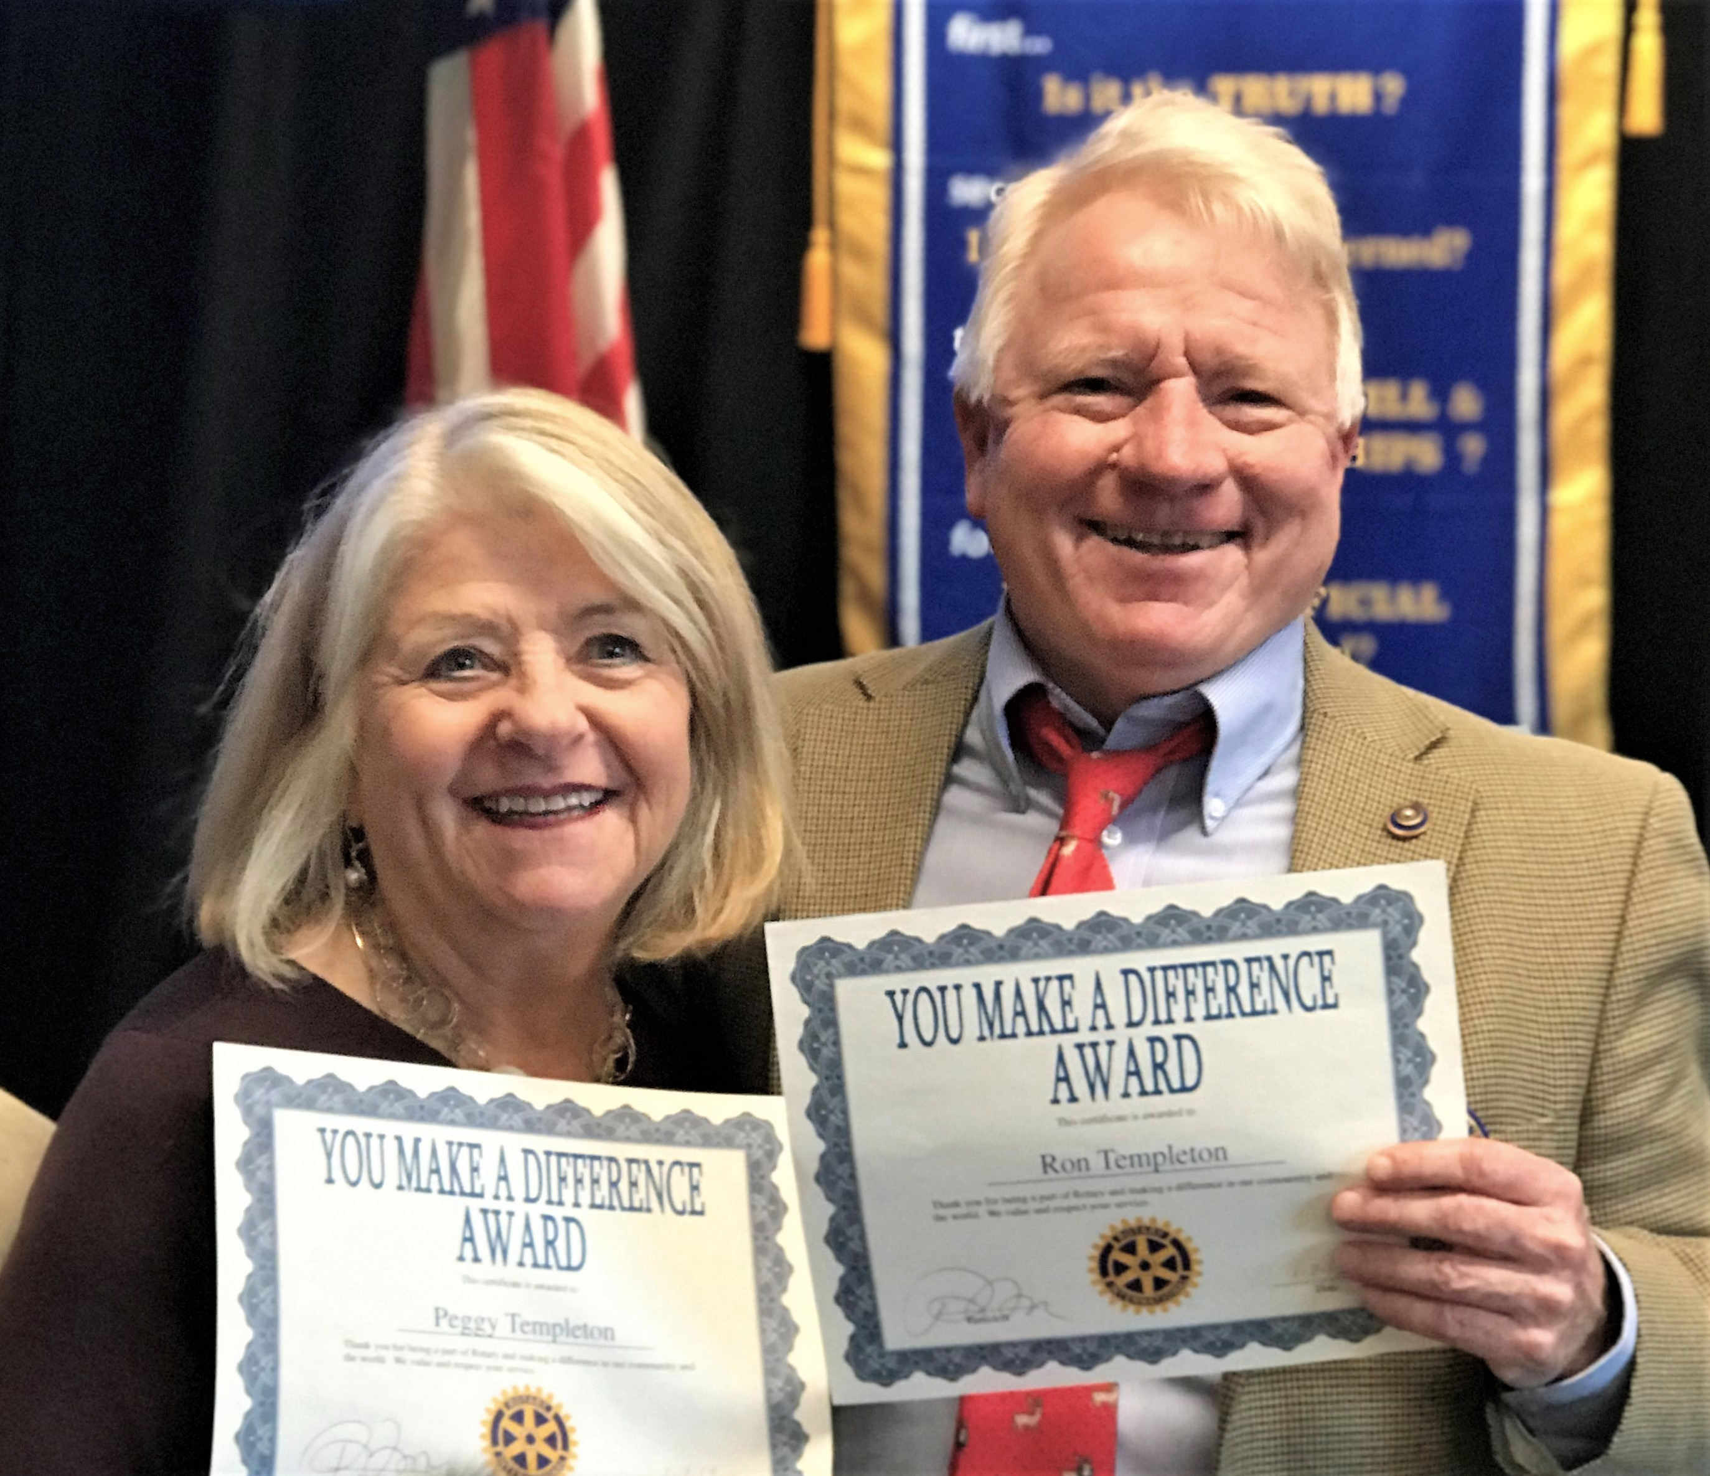
Devoted Husband, Father, Host Dad, Rotarian
Peggy Templeton

